Slide 1

ECE 281 Lesson 10
Maj Walchko
1

Slide 2
Lesson 10 Outline
Do Time Logs!
Adders
Half Adder
Full Adder
Carry Propagate
Subtractors
Comparators
Equality
Magnitude
Due Now! - Lab 1 Lab Notebook Due BOC

Slide 3
Big Picture
What are we going to do in this class?
Ultimately we are going to build a MIPS processor
What do we need?
Arithmetic logic unit (ALU)
Add
Subtract
Compare

Slide 4
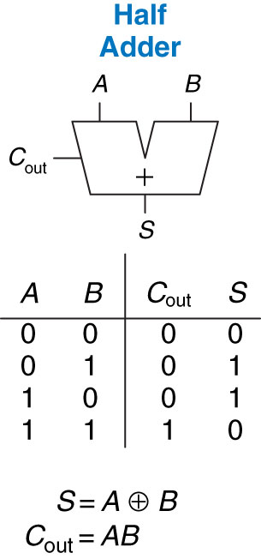
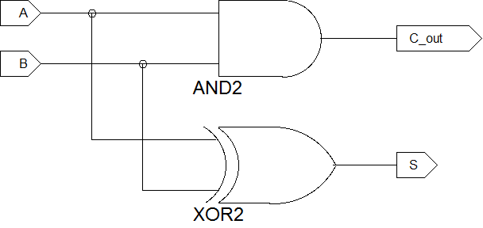
Half Adder
 | B |  | S
A |  | 0 |  | 1
 | 0 | 0 |  | 1
 |  | 0 |  | 1
 | 1 | 4 |  | 5
 |  | 1 |  | 0

Slide 5
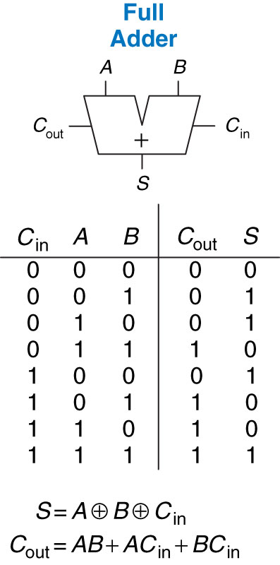
Full Adder

Slide 6
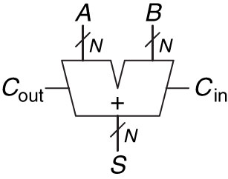
Carry Propagate Adder
Types:
Ripple Carry
Carry Lookahead
Prefix Adder

Slide 7
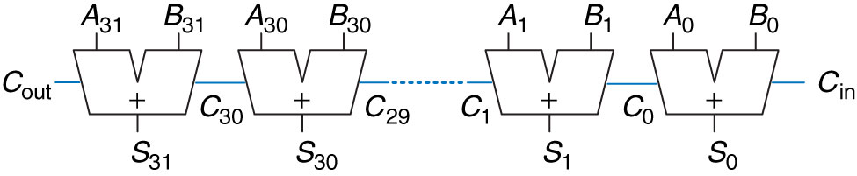
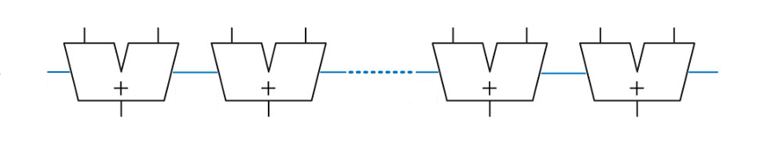
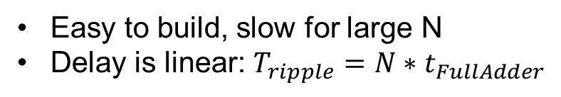
Ripple-Carry Adder
Easy to build, slow for large N
Delay is linear: $T_{ripple}=N∗t_{FullAdder}$

Slide 8
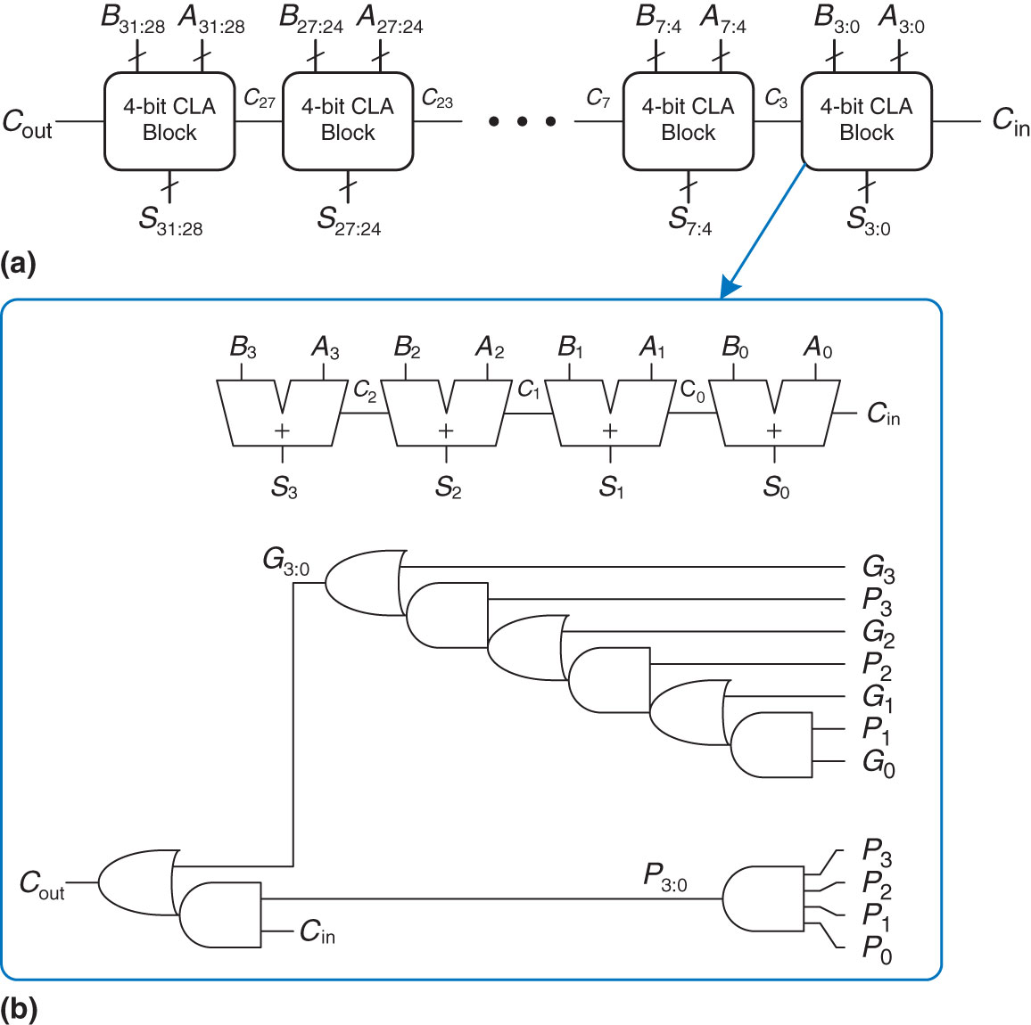
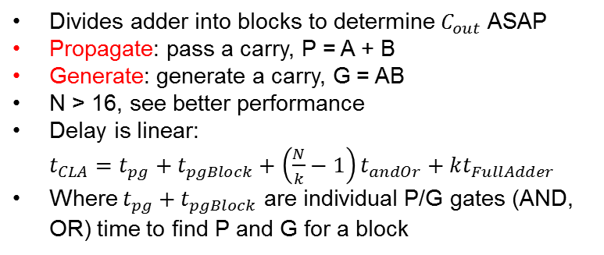
Carry - Lookahead Adder
Divides adder into blocks to determine $C_{out}$ ASAP
Propagate: pass a carry, P = A + B
Generate: generate a carry, G = AB
N > 16, see better performance
Delay is linear: $t_{CLA}=t_{pg}+t_{pgBlock}+\left(\frac{N}{k}−1\right)t_{andOr}+kt_{FullAdder}$
Where $t_{pg}+t_{pgBlock}$ are individual P/G gates (AND, OR) time to find P and G for a block
$$C_{i}=A_{i}B_{i}+\left(A_{i}+B_{i}\right)C_{i−1}=G_{i}+P_{i}C_{i−1}$$
32-bit carry - lookahead adder (CLA), (b) 4-bit CLA block

Slide 9

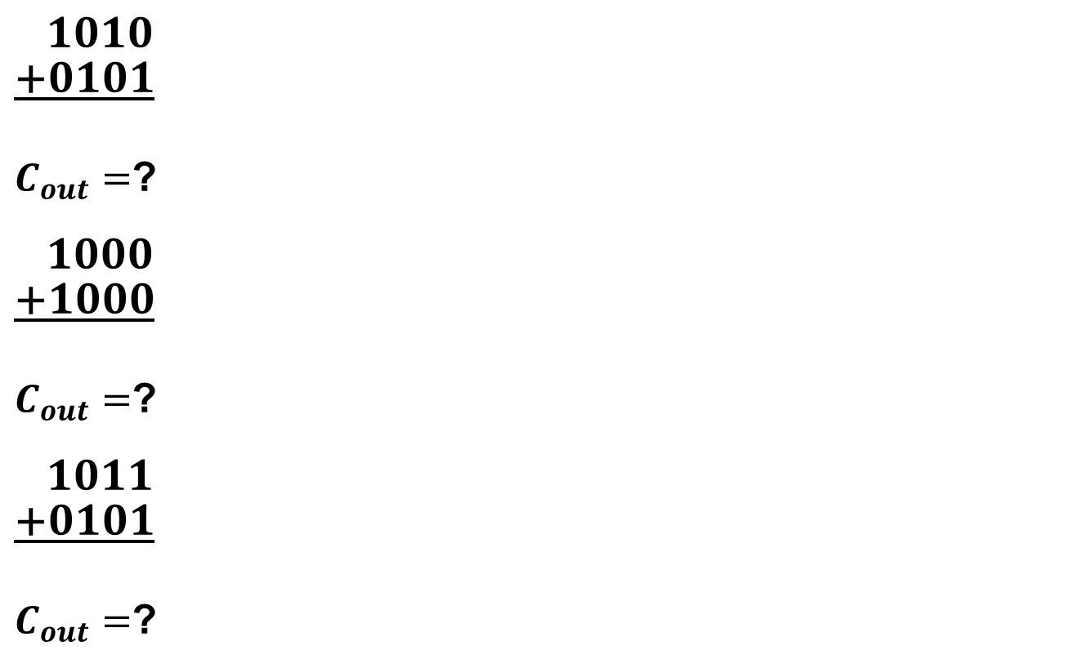
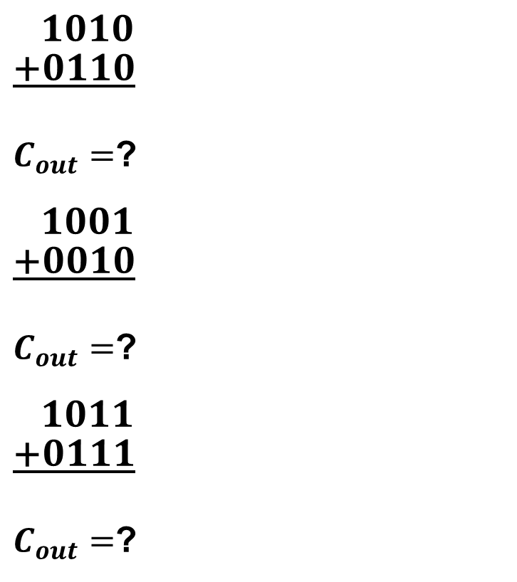
Generate/Propagate Examples
$\frac{\begin{aligned} 1010 \\ +0101\end{aligned}}{ }$
$C_{out}=$?
$\frac{\begin{aligned} 1000 \\ +1000\end{aligned}}{ }$
$C_{out}=$?
$\frac{\begin{aligned} 1011 \\ +0101\end{aligned}}{ }$
$C_{out}=$?
$\frac{\begin{aligned} 1010 \\ +0110\end{aligned}}{ }$
$C_{out}=$?
$\frac{\begin{aligned} 1001 \\ +0010\end{aligned}}{ }$
$C_{out}=$?
$\frac{\begin{aligned} 1011 \\ +0111\end{aligned}}{ }$
$C_{out}=$?
←$C_{in}=1$
0000
0000
1
1
←$C_{in}=1$
0000
1100
1
0
0000
0010
1
1

Slide 10
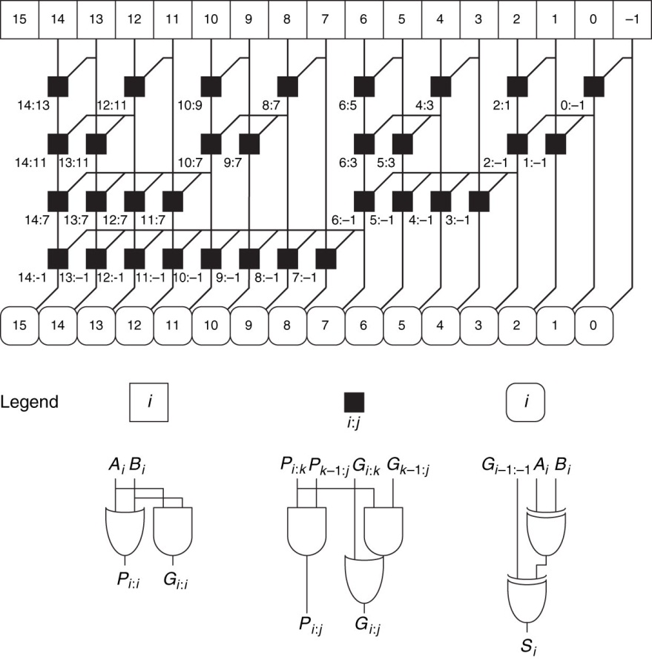
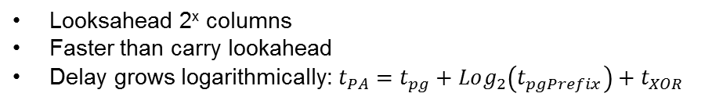
16-Bit Prefix Adder
Looksahead 2^{x} columns
Faster than carry lookahead
Delay grows logarithmically: $t_{PA}=t_{pg}+Log_{2}\left(t_{pgPrefix}\right)+t_{XOR}$

Slide 11
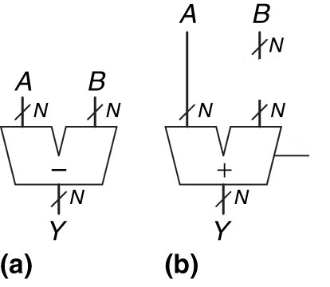
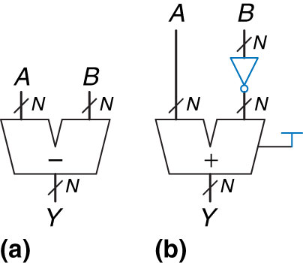
Subtractor
How do we subtract?
2’s complement
Invert numbers
Adds 1

Slide 12
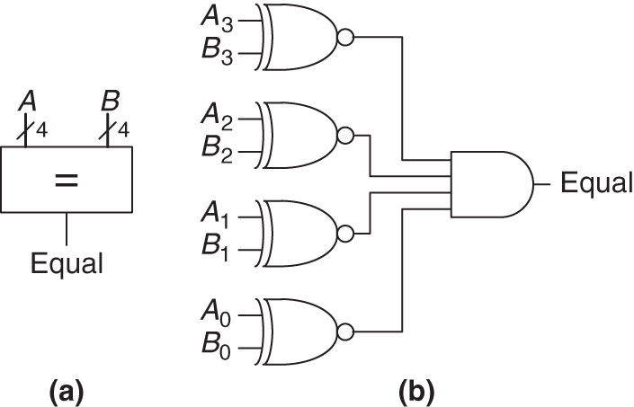
Equality Comparator
XNOR
A | B | Y
0 | 0 | 1
0 | 1 | 0
1 | 0 | 0
1 | 1 | 1
Why are we using this?
Need something to compare all bits
XOR is True when all bits are different and False when the same
XNOR thus gives True when they are all the same

Slide 13
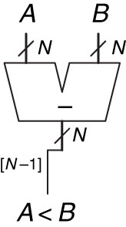
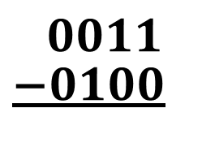

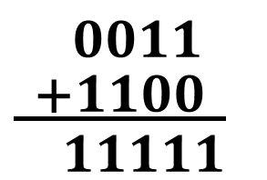
Magnitude Comparator
$\frac{\begin{aligned} 0011 \\ −0100\end{aligned}}{ }$
A = 3
B = 4
$\frac{\begin{aligned} 0011 \\ +1100\end{aligned}}{ 11111}$
Look at MSB to see if A < B, meaning the result is negative if 1, hence smaller
$$GreaterThan=\overline{Equal}∗\overline{LessThan}$$

Slide 14
N-Bit Comparator
N-Bit Comparator Entity
A
B
G
E
L

Slide 15
Implementation
Implement this function using things we learned today?
No Gates..Just Logic Functions (add, subtract, compare, etc)
If a < 4
z = y + 3
else
z = y + 7
A
4
7 3
L
s
0 1
Y
+
Z

Slide 16

16

Slide 17
Half Adder - Schematic

Slide 18
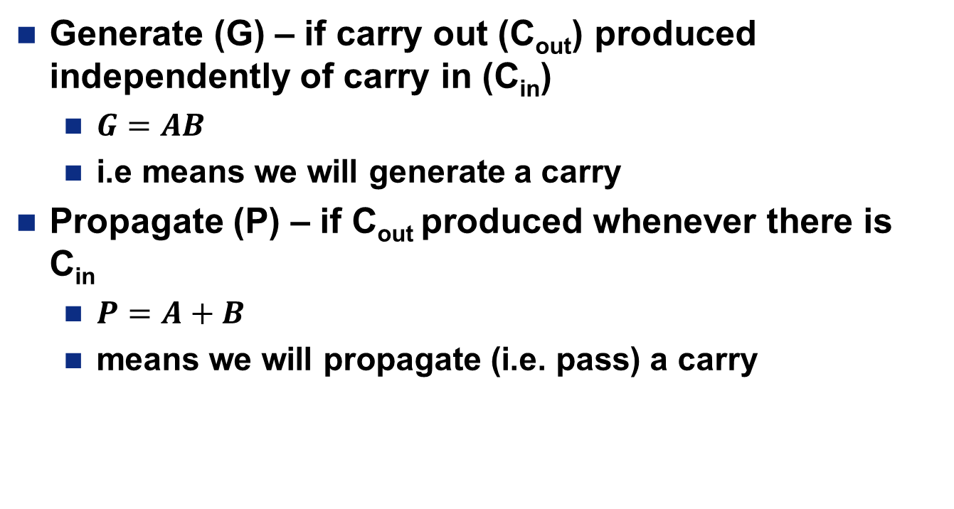
Generate vs Propagate Carry
Generate (G) – if carry out (C_{out}) produced independently of carry in (C_{in})
$G=AB$
i.e means we will generate a carry
Propagate (P) – if C_{out} produced whenever there is C_{in}
$P=A+B$
means we will propagate (i.e. pass) a carry

